Slide 1
SNF RRAM Standard Process Flow and Characterization of Lesker-2 TiN
ENGR241 Week 5 Updates
Project Members: Akash Levy, Jung-Soo Ko
Staff Mentors: Michelle Rincon, Vijay Narasimhan, J Provine, Usha Raghuram

Slide 2
Aim & Goals
Test and characterize ALD RRAM devices
Develop TiN recipe on new Lesker with low oxygen contamination
Compare TiN properties (composition, resistivity, topography)
Make electrical/imaging data and test structure layouts available to SNF
Make SOPs for RRAM stacks and report TiN findings
Process Flow Development
Parameter Optimization
Comprehensive Documentation
SNF Database

Slide 3
Progress Updates: Fabrication
Clean and grow SiO₂ for isolation
Sputter 30nm TiN (Sharpie for step)
AJA (non-SNF)
Lesker-1 (SNF)
Lesker-2 (SNF)
AJA Characterization
XPS
Prometrix
AFM
Alphastep
Auger
Lesker-1 Characterization
XPS
Prometrix
AFM
Alphastep
Auger
Lesker-2 Characterization
Underlined is planned to be done by next checkpoint
TiN
Update: Lesker-2 training starting soon!
SiO₂
Si

Slide 4
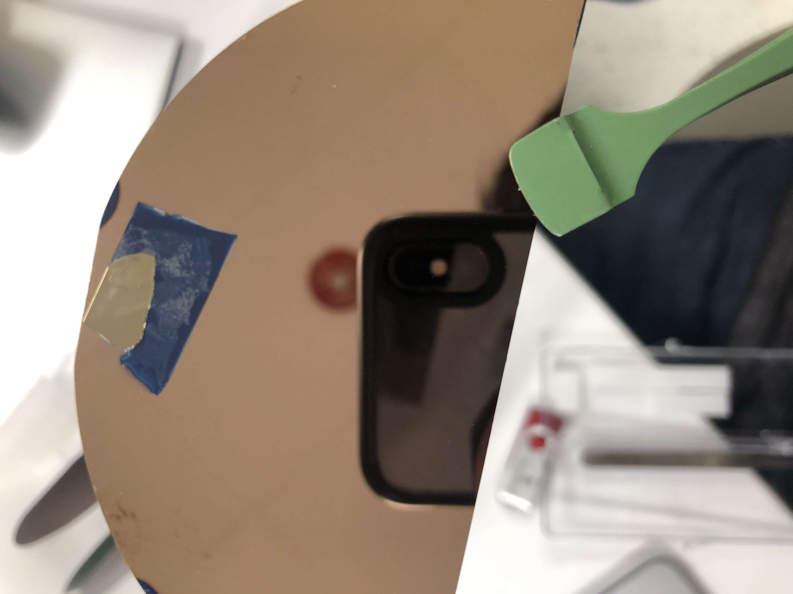
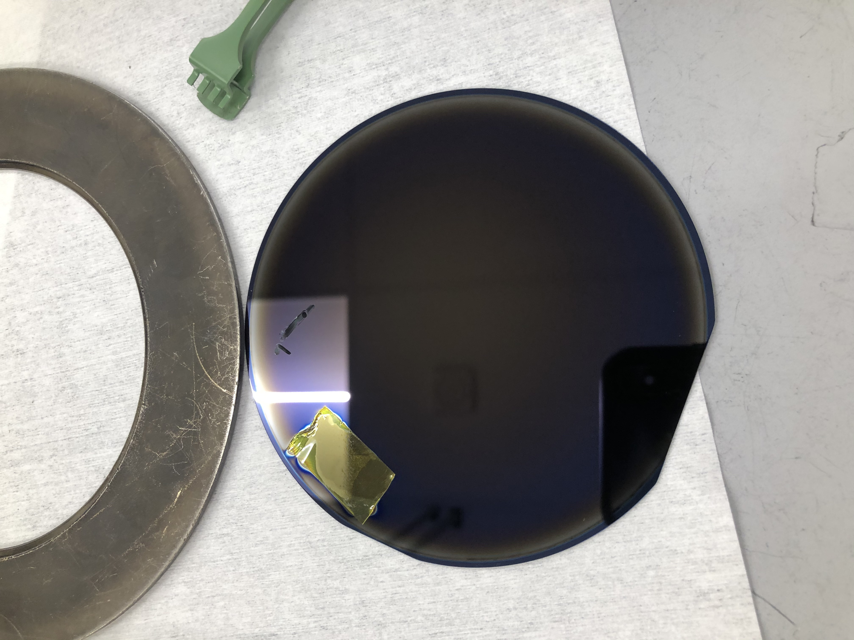
TiN Film Comparison
AJA
Lesker-1

Slide 5
Literature Review on TiN Sputtering
TiN films absorb a high concentration of contaminants including hydrogen, carbon, and oxygen when they are exposed to air after deposition
With the target–substrate distance set to 88 mm the contaminant levels increase from ∼0.1% to ∼10% as the pressure is increased from 2 to 9 mTorr
The contaminant concentrations also correlate with in-plane distance from the center of the substrate and increase by roughly two orders of magnitude as the target–substrate distance is increased from 88 to 266 mm
Contaminants strongly influence properties of TiN thin films
Resistivity of stoichiometric films increases by around a factor of 5 as the oxygen content increases from 0.1% to 11%
Energy of the sputtered TiN particles plays crucial role in determining the film properties
Important to precisely control the energy of these particles to obtain high-quality TiN
Ohya, S., B. Chiaro, A. Megrant, C. Neill, R. Barends, Y. Chen, J. Kelly et al. "Room temperature deposition of sputtered TiN films for superconducting coplanar waveguide resonators." Superconductor Science and Technology 27, no. 1 (2013): 015009.

Slide 6
TiN Properties
 | AJA: A1 | Lesker-1: X1 | Lesker-1: X2 | Lesker-1: X3 | Lesker-1: X4 | Lesker-1: X5
Target | Ti | TiN | TiN | TiN | Ti | TiN
Base Pressure | ~1e-7 Torr | ~1e-6 Torr | ~1e-6 Torr | ~1e-7 Torr (?) | ~1e-7 Torr (?) | ~1e-7 Torr
RF Power | 200W | 150W | 200W | 200W | 200W | 200W
Gettering/Chamber Conditioning | 2 min TiN | 2 min TiN | 5 min Ti, 5 min TiN | 5 min Ti, 5 min TiN | 5 min Ti, 5 min TiN | 10 min Ti, 5 min TiN
Wafer Bias | 100V | 100V | 100V | 100V | 100V | 100V
Ar/N Flow | 30/3 sccm | 50/5 sccm | 30/3 sccm | 30/0 sccm | 30/3 sccm | 30/3 sccm
Pressure | 2.15 mTorr | 5 mTorr | 3 mTorr (5.5) | 2 mTorr | 2 mTorr | 2 mTorr
Sheet Resistance | 15.650 Ω/□ | ? | ?
Resistivity | ? | ? | ?
Uniformity/Color | Excellent | Bad | Good
Thickness/Time | ?nm/1800s | ?nm/1800s | ?nm/900s |  |  | ?nm/1800s
Roughness | 0.67nm | ? | ?
Composition (Ti:N:O) | 46:51:3 | ? | ?

Slide 7
Progress Updates
Underlined is planned to be done by next checkpoint
RCA clean wafer
Grow 50nm SiO₂ with thermco4 (20 min. of 900C wet growth)
Deposit 10nm Ti with AJA (skipped)
Deposit 30nm Pt with AJA
Deposit 100nm SiO₂ with AJA
Woollam to check oxide thickness (834Å)
Photolithography (1)
YES Oven for 30 mins
SVG Coat 2 with 1µm Shipley 3612 resist, 2mm EBR, skip prime step
Expose with Heidelberg (use defoc: -2, dose: 70/80 for Heidelberg1/2, 350nm)
SVG Develop (1µm 3612 dev) w/post-exposure bake and inspect
PT-Ox: Oxide_ER_Test, 1 min
Resist ashing: Gasonics recipe 003 (1)
Metal cleaning on wbflexcorr (1)
SRS-100 for stripping photoresist from metal wafers, 60C
PRS-1000 for final metal clean before deposition or furnace step, 40C
Alphastep to check etching
Fiji1 thermal HfO₂: 100 cyc. std. recipe
Woollam to check oxide thickness
TiN deposition 30nm
Photolithography (2)
PT-MTL: still need details
Microscope to check etching
Resist ashing: Gasonics recipe 003 (2)
Metal cleaning on wbflexcorr (2)
Electrical testing
Notes:
Dose: 70, defoc: -2 on Heidelberg-2
Dose: 80ish, defoc: -2 on Heidelberg-1

Slide 8
Thank you!
Questions?

Slide 9
AFM Roughness Measurements: AJA
Roughness: 1.02nm SiO₂
Roughness: 1.22nm TiN
0.67nm independent

Slide 10
AJA TiN Sputter Recipe: Reactive Sputtering
Target: Ti
RF Power: 200W
150W also ok; different dep rates
Wafer Bias: 100V
DC bias 92-94V on AJA in practice
Ar Flow: 30 sccm
N Flow: 3 sccm
Unit conversion means that this is written as 30 on AJA somehow
Set Pressure: 2.15 mTorr
1.8-1.9 mTorr on AJA in practice
Recipe:
Load sample and wait for 1e-7 base chamber pressure
Plasma on another target (conductive) e.g. Al, GeTe
Eases plasma ignition for TiN target
Plasma on Ti target
Bias on other target off
20s ramp-up of Ti target RF power
2 minutes pre-sputtering of Ti target (shutter closed, no wafer bias)
20s ramp-up of wafer bias
Open shutter and deposit for X seconds
Close shutter
20s ramp-down of Ti target RF power

